Slide 1

Geometry
Unit 5, Lesson H1 Definition of Congruence in Terms of Rigid Transformations Volume 1, pg. 257

Slide 2


Benchmark
MA.912.GR.2.7
Justify the criteria for triangle congruence using the definition of congruence in terms of rigid transformations.
volume 1, pg. 257

Slide 3
Integrated Mathematical Thinking and Reasoning Standard
MA.K12.MTR.5.1
Use patterns and structure to help understand and connect mathematical concepts.
volume 1, pg. 257

Slide 4

Learning Target
I can use the definition of congruence to justify that SSS congruence, SAS congruence, ASA congruence, and AAS congruence are sufficient to show that two triangles are congruent.
volume 1, pg. 257

Slide 5

Warm-Up
volume 1, pg. 257

Slide 6
5.H1.1 Warm-Up: Geometry as an Animal
If geometry were an animal, it would be a …
because …
It would live in …
because …
volume 1, pg. 257

Slide 7

Exploration
volume 1, pg. 258

Slide 8

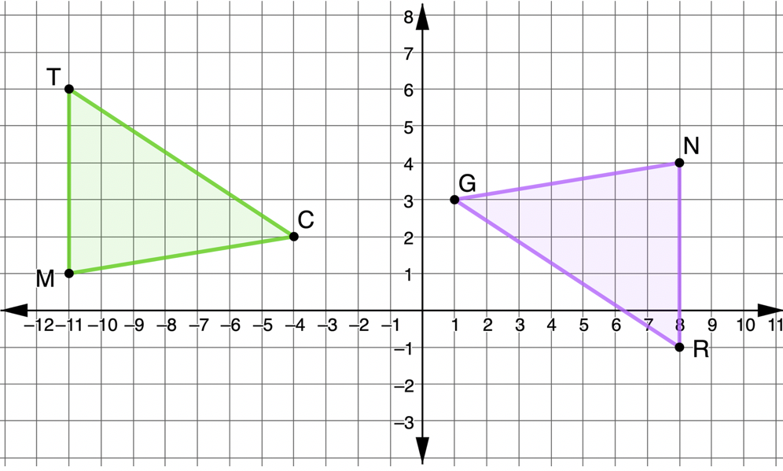
5.H1.2 Exploration: Justifying Congruence
Triangles $TCM$ and $RGN$ are shown, where $\overline{TM}≅\overline{RN}$, $\overline{MC}≅\overline{NG}$, and $∠TMC≅∠RNG$.
Discuss with your partner what can be concluded from the given information.
volume 1, pg. 258

Slide 9
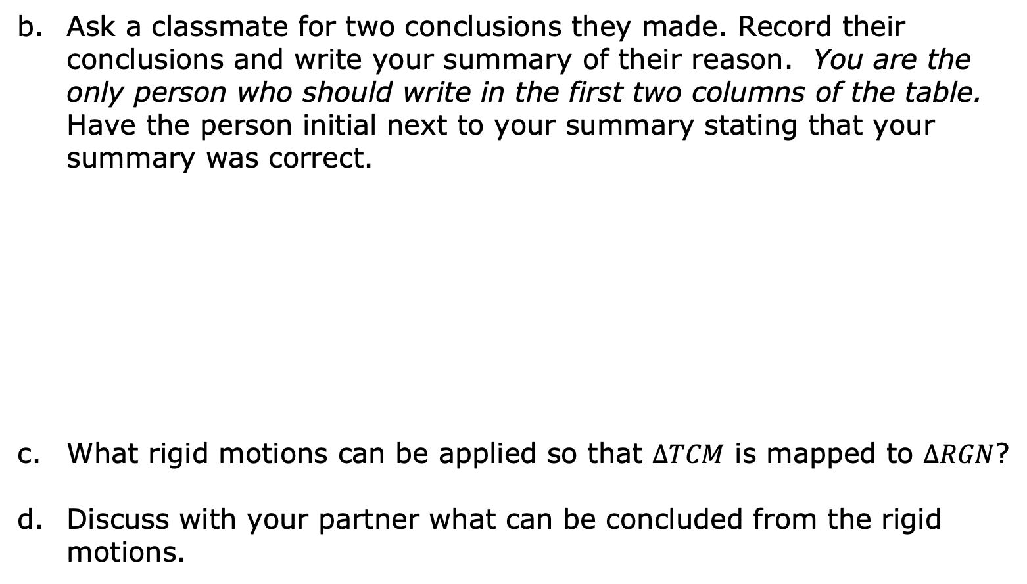
Ask a classmate for two conclusions they made. Record their conclusions and write your summary of their reason. You are the only person who should write in the first two columns of the table. Have the person initial next to your summary stating that your summary was correct.
What rigid motions can be applied so that $∆TCM$ is mapped to $∆RGN$?
Discuss with your partner what can be concluded from the rigid motions.
Conclusion | My Summary of Their Reason | Initials
volume 1, pg. 258

Slide 10
Ask a classmate for two conclusions they made. Record their conclusions and write your summary of their reason. You are the only person who should write in the first two columns of the table. Have the person initial next to your summary stating that your summary was correct.
Discuss with your partner why showing that the triangles are congruent using the definition of congruence in terms of rigid transformations shows that SAS congruence is sufficient to prove the triangles are congruent. Summarize your discussion.
Conclusion | My Summary of Their Reason | Initials
volume 1, pg. 259

Slide 11
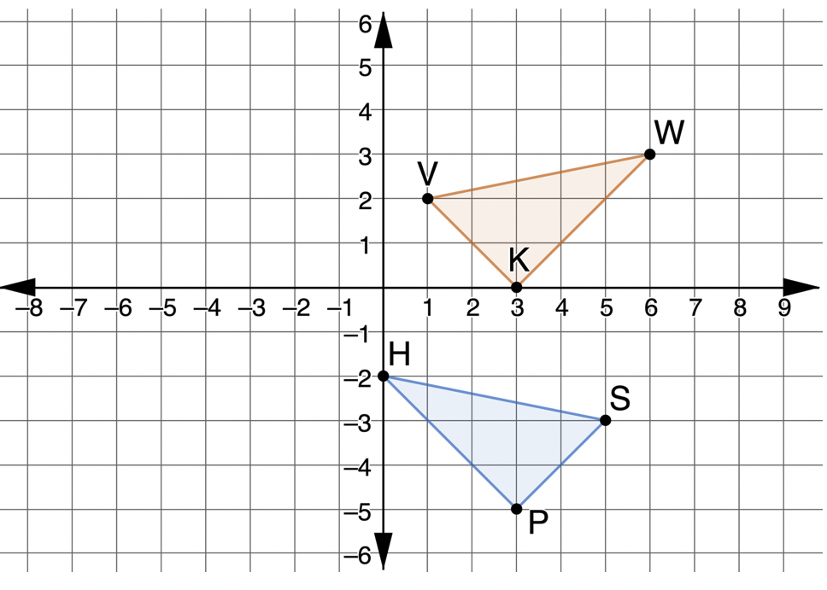
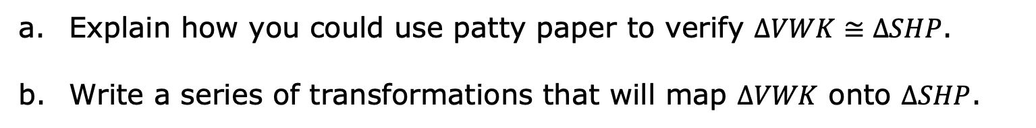

Triangles $VWK$ and $SHP$ are shown. Assume $\overline{VK}≅\overline{SP}$, $\overline{WV}≅\overline{HS}$, and $\overline{KW}≅\overline{PH}$.
Explain how you could use patty paper to verify $∆VWK≅∆SHP$.
Write a series of transformations that will map $∆VWK$ onto $∆SHP$.
volume 1, pg. 259

Slide 12
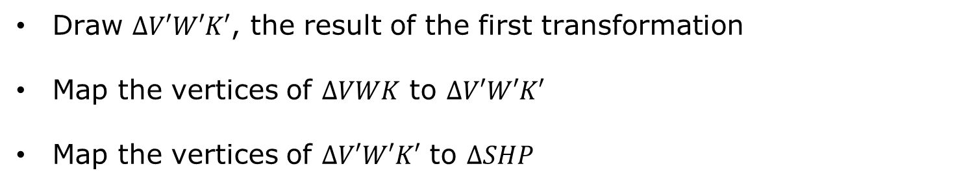
Show each on the coordinate grid.
Draw $∆V′W′K′$, the result of the first transformation
Map the vertices of $∆VWK$ to $∆V′W′K′$
Map the vertices of $∆V′W′K′$ to $∆SHP$
volume 1, pg. 260

Slide 13
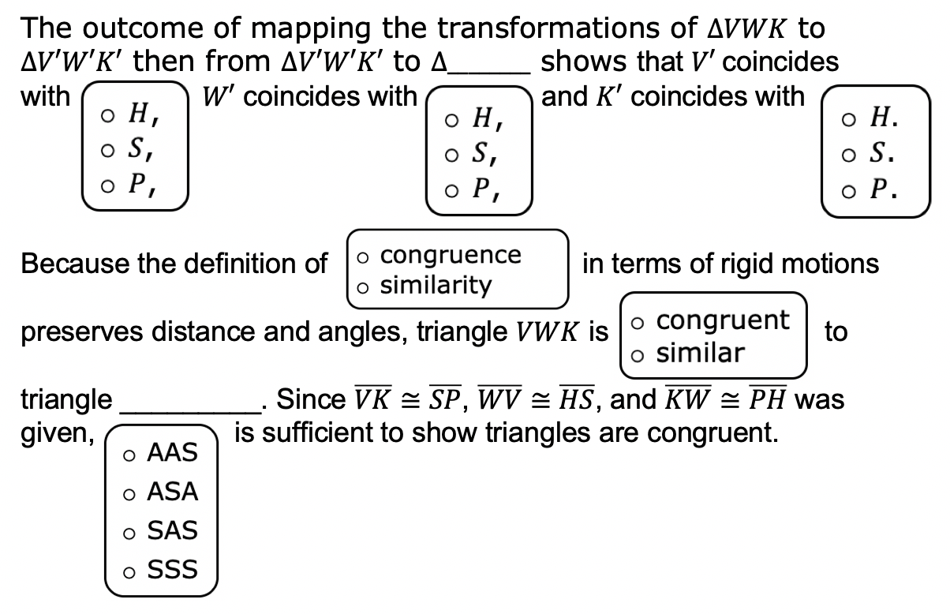
Complete the statements.
volume 1, pg. 260

Slide 14
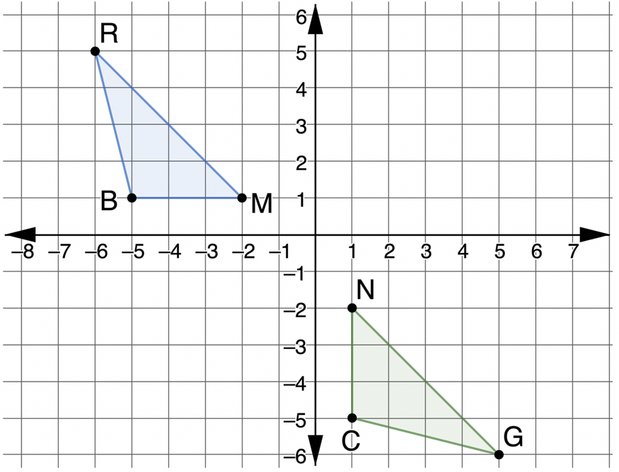

Triangles $RMB$ and $GNC$ are shown, where $\overline{RM}≅\overline{GN}$, $∠BRM≅∠CGN$, and $∠BMR≅∠CNG$.
Adriana knows that there is a series of rigid motions that maps $∆RMB$ onto $∆GNC$.
volume 1, pg. 260

Slide 15
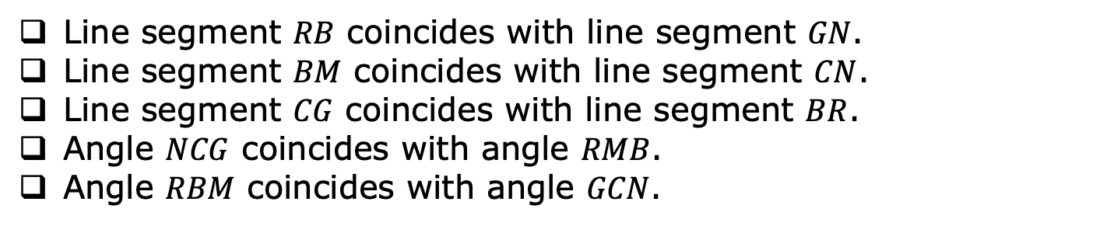
Select all true statements after the transformations.
Line segment $RB$ coincides with line segment $GN$.
Line segment $BM$ coincides with line segment $CN$.
Line segment $CG$ coincides with line segment $BR$.
Angle $NCG$ coincides with angle $RMB$.
Angle $RBM$ coincides with angle $GCN$.
volume 1, pg. 260

Slide 16
Explain how the given information and the definition of congruence in terms of rigid motions shows that $∆RMB≅∆GNC$.
volume 1, pg. 261

Slide 17

Wrap-Up
volume 1, pg. 261

Slide 18

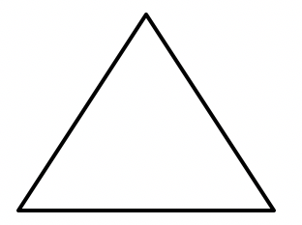

5.H1.3 Wrap-Up: Reflection
What is something that is now “squared away” in your mind about the definition of congruence in terms of rigid transformations?
What are three “points” that are important for showing triangle congruence using the definition of congruence in terms of rigid transformations?
What is something that is still “circling” your brain about the definition of congruence in terms of rigid transformations?
volume 1, pg. 261

